Slide 1
Learn Factory integration Digital Transformation for Hydraulic Systems

Slide 2
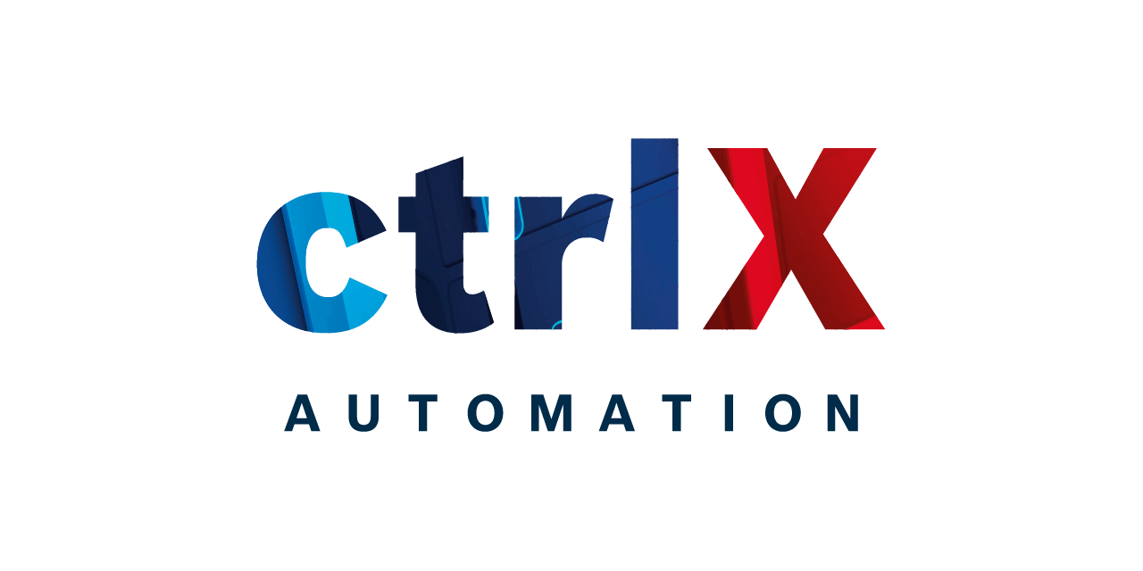
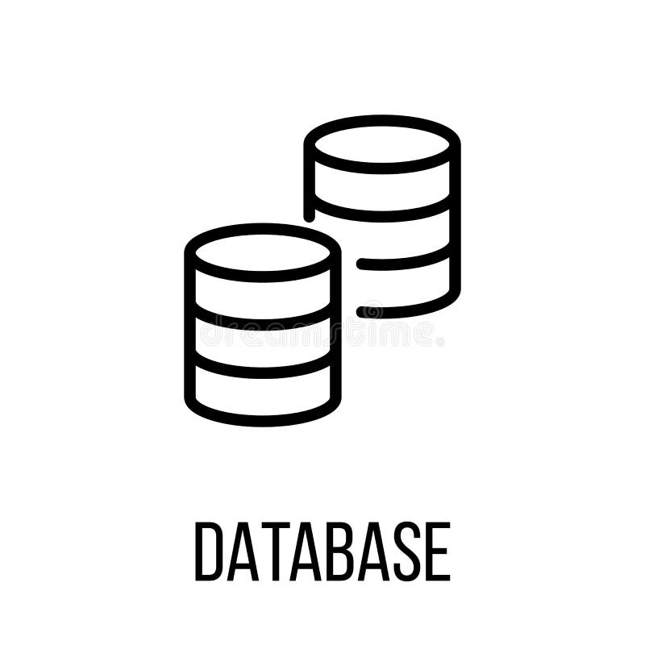
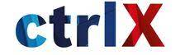
This is a standard product that can be used by any user with basic configurations to transfer data from any Control X to a database, which can be either physical or cloud-based.
Extraction
Transformation
Load
Docker Dagster
Orchestrator
Docker Transform
Docker Load
Docker Extract
Re connection Extract
No
Extract
Are there
messages
From the
broker?
Load
Transform
Yes
Docker Solace
SOLACE BROKER
Docker DB
Data Base (cloud)

Slide 3
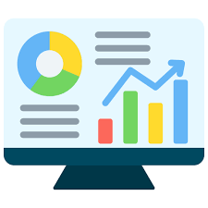
Why?
Temperature
PLC Condition = Threshold
Time
Data Base = History > Year
T/2
T = 60days
AI Model
Anomaly Behavior
User
15% Variation 25% Variation
Models learn from complete trends not points
Every 10 seconds
Daily
Monthly

Slide 4
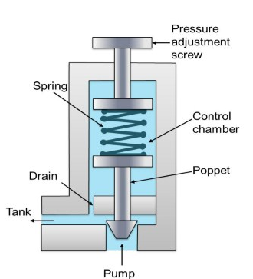
In an hydraulic Application
Relief Valves
K
2%
+
3%
+
4%
+
4%
+
4%
K=
17%
Replacement
at 20%
Time
User
Current K
History of normal behavior

Slide 5
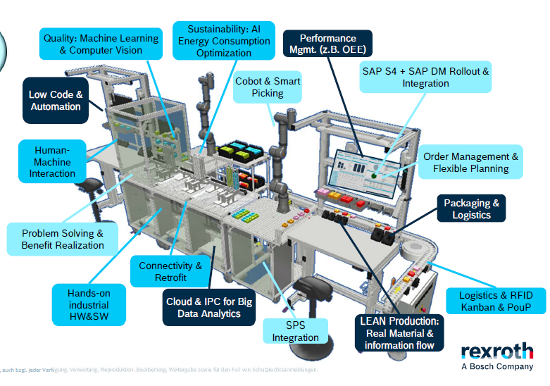
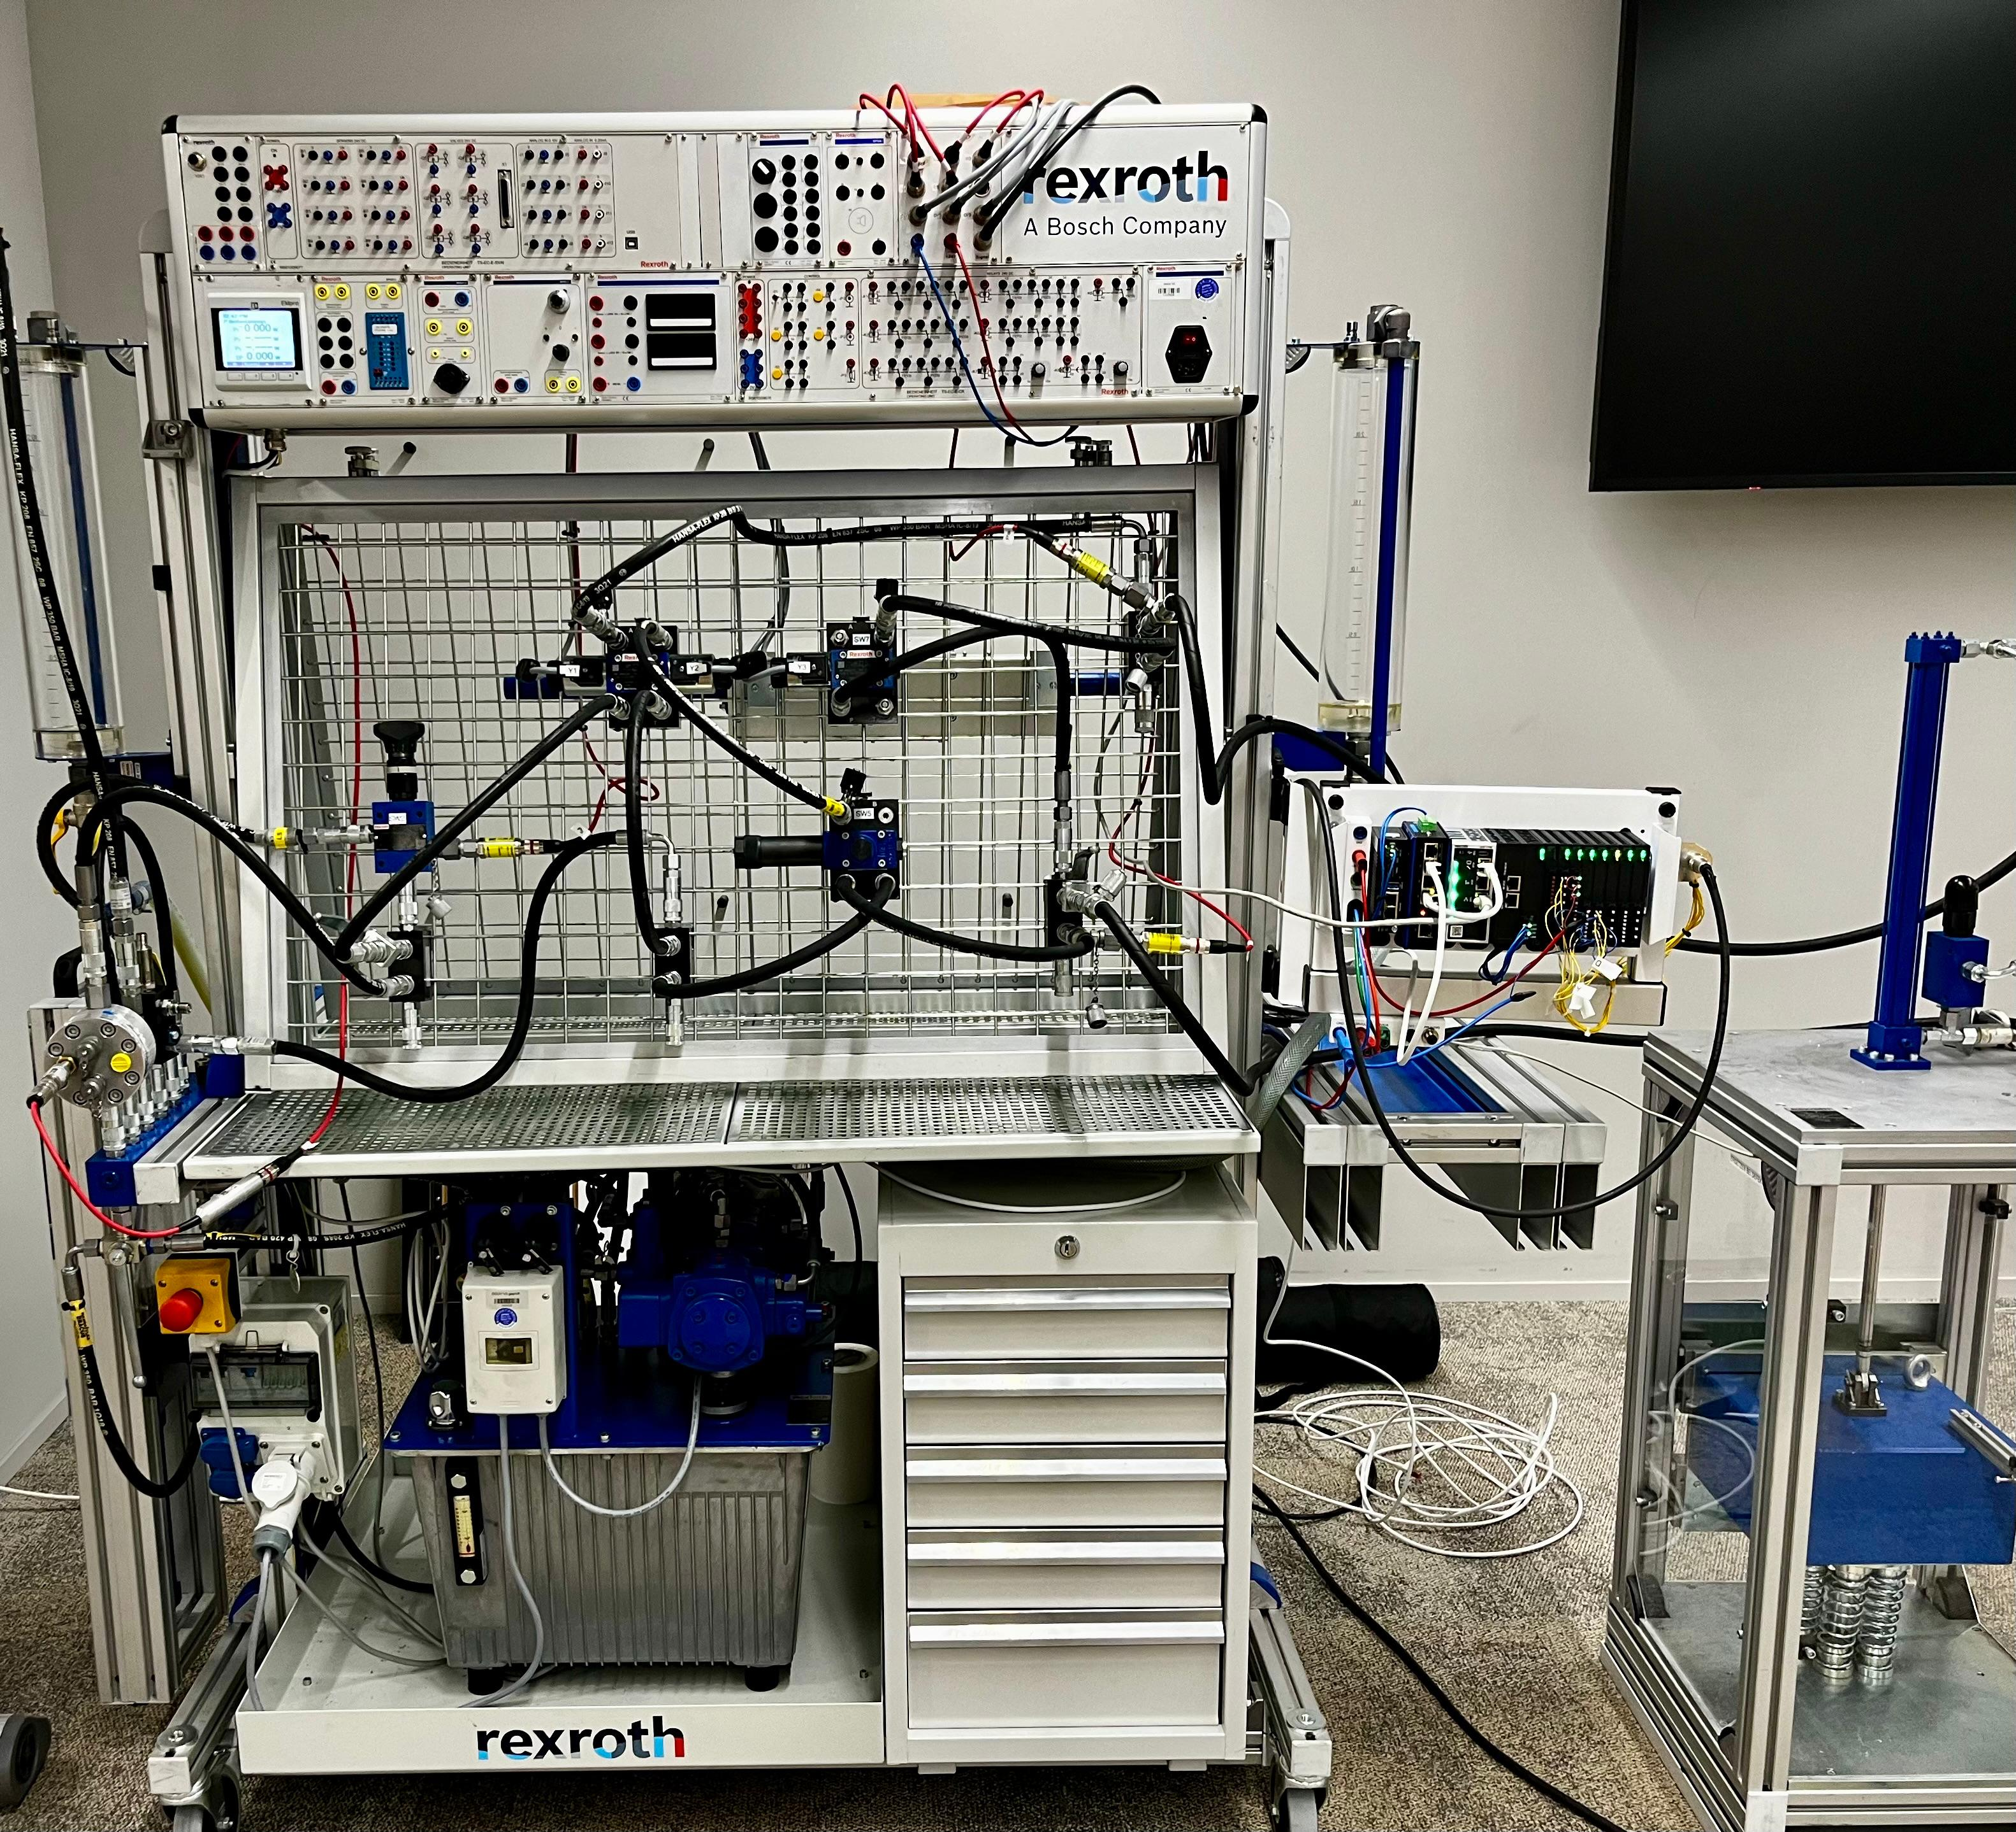
Target: Enable the Automax 105# to have the same analysis and monitoring capabilities as the Learn Factory.
No data storage
No historical analysis
Monitoring based on hard-coded PLC conditions
Integration

Slide 6
Learn Factory integration Paper/Thesis: From Rule-Based PLC Monitoring to AI-Driven Anomaly Detection in Hydraulic Systems

Slide 7
Thank you!

